Slide 1
Autism in the United States
Autism Prediction
Notes:
Segment 1 Requirements:
✓ Selected topic
Reason why they selected their topic
Description of their source of data
✓ Questions they hope to answer with the data
*Note: The content does not yet need to be in the form of a presentation; text in the README.md works as well.

Slide 2
Reason Topic Was Selected
Autism is a newer Diagnosis within the DSM and has recently been re categorized in the DSM 5
-Autism diagnosis continue to rise to help provide necessary resources there is much to learn
Including how many individuals will need help and what kinds of help
Find efficient (quick and accurate ways to diagnosis Autism)
It often time can take a year to two to see a doctor to get an official diagnosis, which may prevent treatment
Early invention is essential
Notes:
Segment 1 Requirements:
✓ Selected topic
✓ Reason why they selected their topic
Description of their source of data
Questions they hope to answer with the data
*Note: The content does not yet need to be in the form of a presentation; text in the README.md works as well.

Slide 3
Description of the Source of Data
https://www.census.gov/programs-surveys/nsch.html
https://www.census.gov/programs-surveys/nsch/about.html
Notes:
Segment 1 Requirements:
✓ Selected topic
✓ Reason why they selected their topic
✓Description of their source of data
Questions they hope to answer with the data
*Note: The content does not yet need to be in the form of a presentation; text in the README.md works as well.

Slide 4
Questions they hope to answer with the data
How can we predict Autism as a Diagnosis?
How can predict a diagnosis in the 3-17 year old range?
How can we predict a diagnosis in the 0-2 year old range?
Notes:
Segment 1 Requirements:
✓ Selected topic
✓ Reason why they selected their topic
✓Description of their source of data
✓Questions they hope to answer with the data
*Note: The content does not yet need to be in the form of a presentation; text in the README.md works as well.

Slide 5
Statistics
Used multiple linear regression as it is useful for modelling the relationship between a numeric outcome or dependent variable (Y) and multiple explanatory or independent variables (X)
Used lm() linear model fit that helped decide if regression, single stratum analysis of variance or analysis of covariance was the best fit
aov()
summary()
Example(model12)
Plot()
Example plot(model12)

Slide 6
Machine Learning Reason
Linear
Clustering Anomaly (opposite of clustering) - what stands out and why?
Notes:
Segment 1 Requirements:
✓ Selected topic
✓ Reason why they selected their topic
✓ Description of their source of data
✓ Questions they hope to answer with the data
*Note: The content does not yet need to be in the form of a presentation; text in the README.md works as well.

Slide 7
Presentation

Slide 9
Git Hub

Slide 10
Machine Learning Model

Slide 11
Database

Slide 12
Dashboard

Slide 13
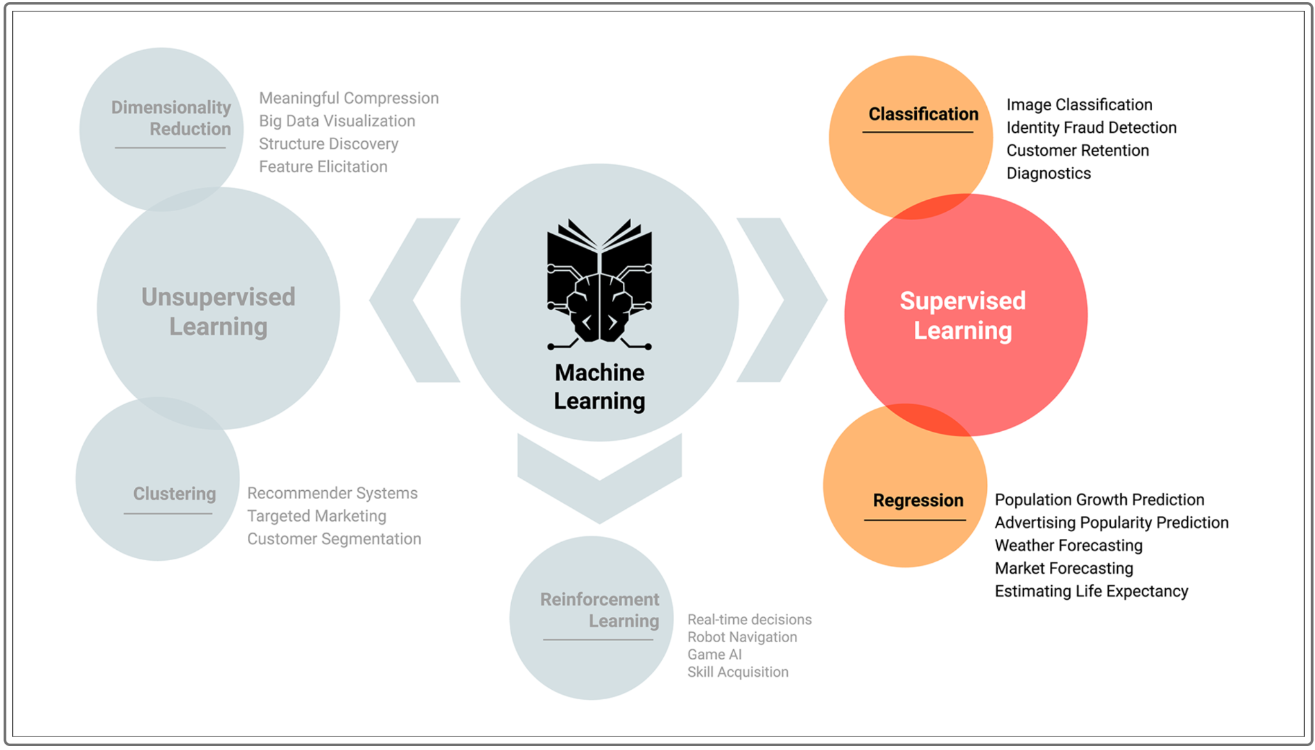

Slide 14
Machine Learning
Linear - predictive diagnosis
Clustering Anomaly (opposite of clustering) - what stands out and why?

Slide 15
Technology
https://app.quickdatabasediagrams.com
PostgreSQL
SQLAlchemy 1.4.22

Slide 16
Description of the Data Exploration Phase
Notes:
Description of the data exploration phase of the project
Description of the analysis phase of the project

Slide 17
Description of the analysis phase of the project

Slide 18
Dashboard Blueprint

Slide 19
Notes from Bosco
-Will run different models, with supporting data
-Add the repo url
-Need to be 4 single commits per session?
-Possible Dashboard make sure

